Slide 1
nEXT 240/300/400 pumping speed vs. rotational speed
John Wood, December 2018

Slide 2
nEXT Pumping speed Vs. rotational speed
The following graph is calculated data and is for guidance only
For specific requirements or further detail please contact the A&D team

Slide 3
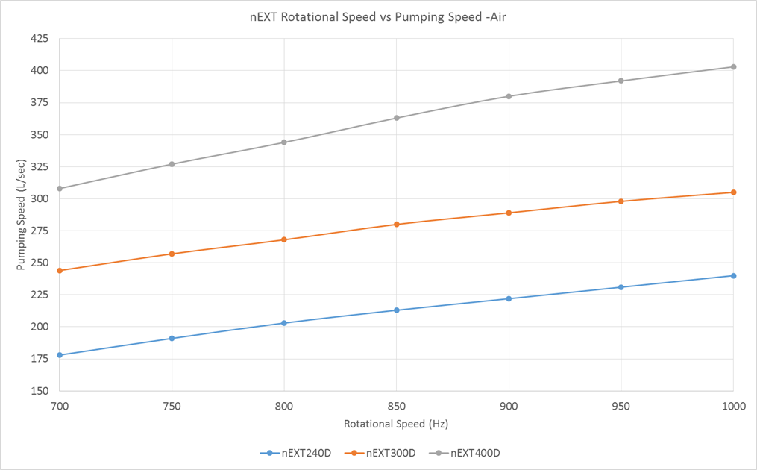
Pumping speed vs. rotational speed

